Slide 1
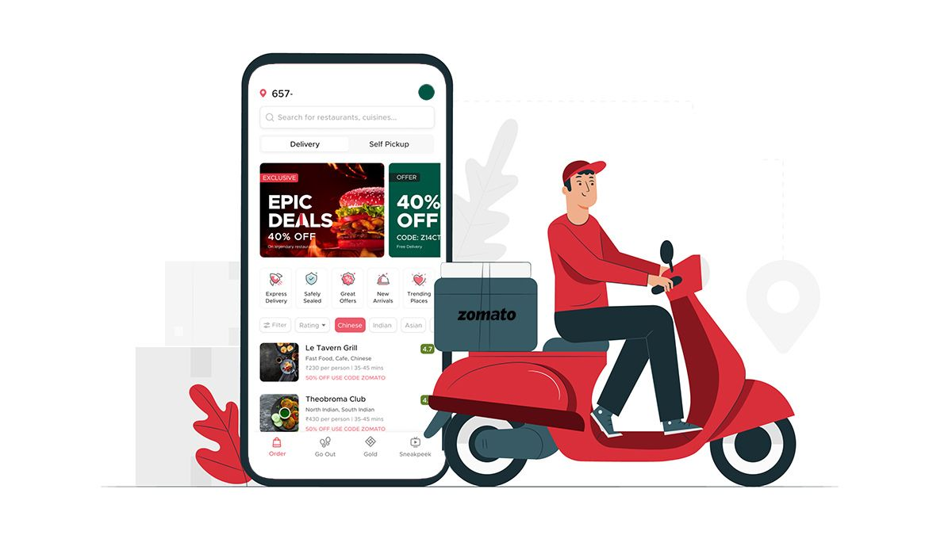
Zomato Restaurant Expansion
Animesh Jana

Slide 2

Agenda
Introduction
Data Overview
Objective
High Demand Areas
Yearwise restaurants Open
Price range
Cost Comparison
Expansion Opportunity
Dashboard
Conclusion

Slide 3
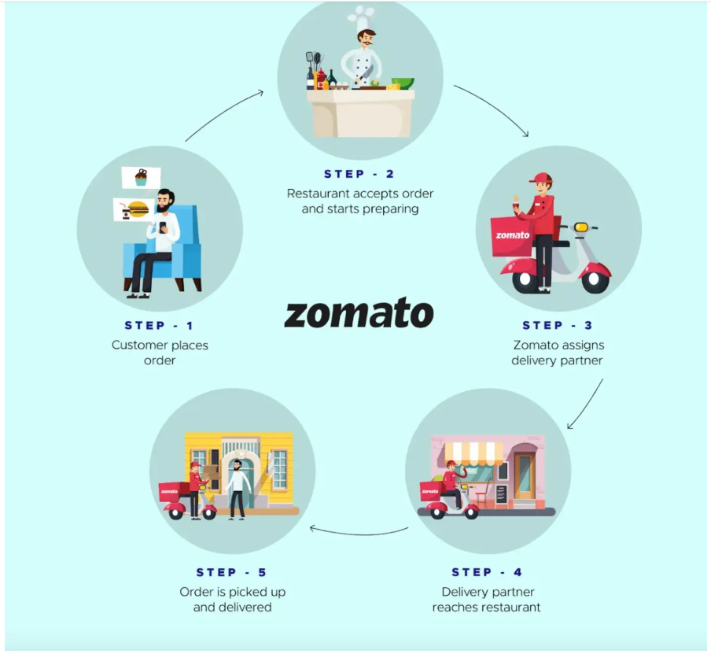
INTRODUCTION
HOW ZOMATO WORKS
It is one of the leading online food delivery service platform. Launched in 2010, the platform connects customers, restaurant partners and delivery partners, serving their multiple needs.
CHALLENGES
It is quite a challenging task to open new restaurants
We have to analyze factors like customer
preference, demand for a specific cuisine,
customer expenditure capability in order
to expand the business.

Slide 4
Problem Statement
What should Zomato consider before expanding?
The business problem
Identify countries and cities suitable for new restaurants.
Understand customer preferences, popular cuisines, and spending capacity.
Consider competition and opportunities to improve customer convenience.
Goal of the analysis
Use restaurant data to compare markets.
Identify opportunities for delivery and table booking.
Recommend expansion choices based on the available data.

Slide 5

Data Overview
The dataset includes 9,551 restaurants across 15 countries and 141 cities.
The average cost for two is ₹856, with an average rating of 2.89.
There are over 1.49 million customer votes and 1,825 unique cuisines.
The data offers insights into pricing, customer preferences, and service trends.
Sourced from Zomato’s public dataset, it serves as the foundation for analysis

Slide 6
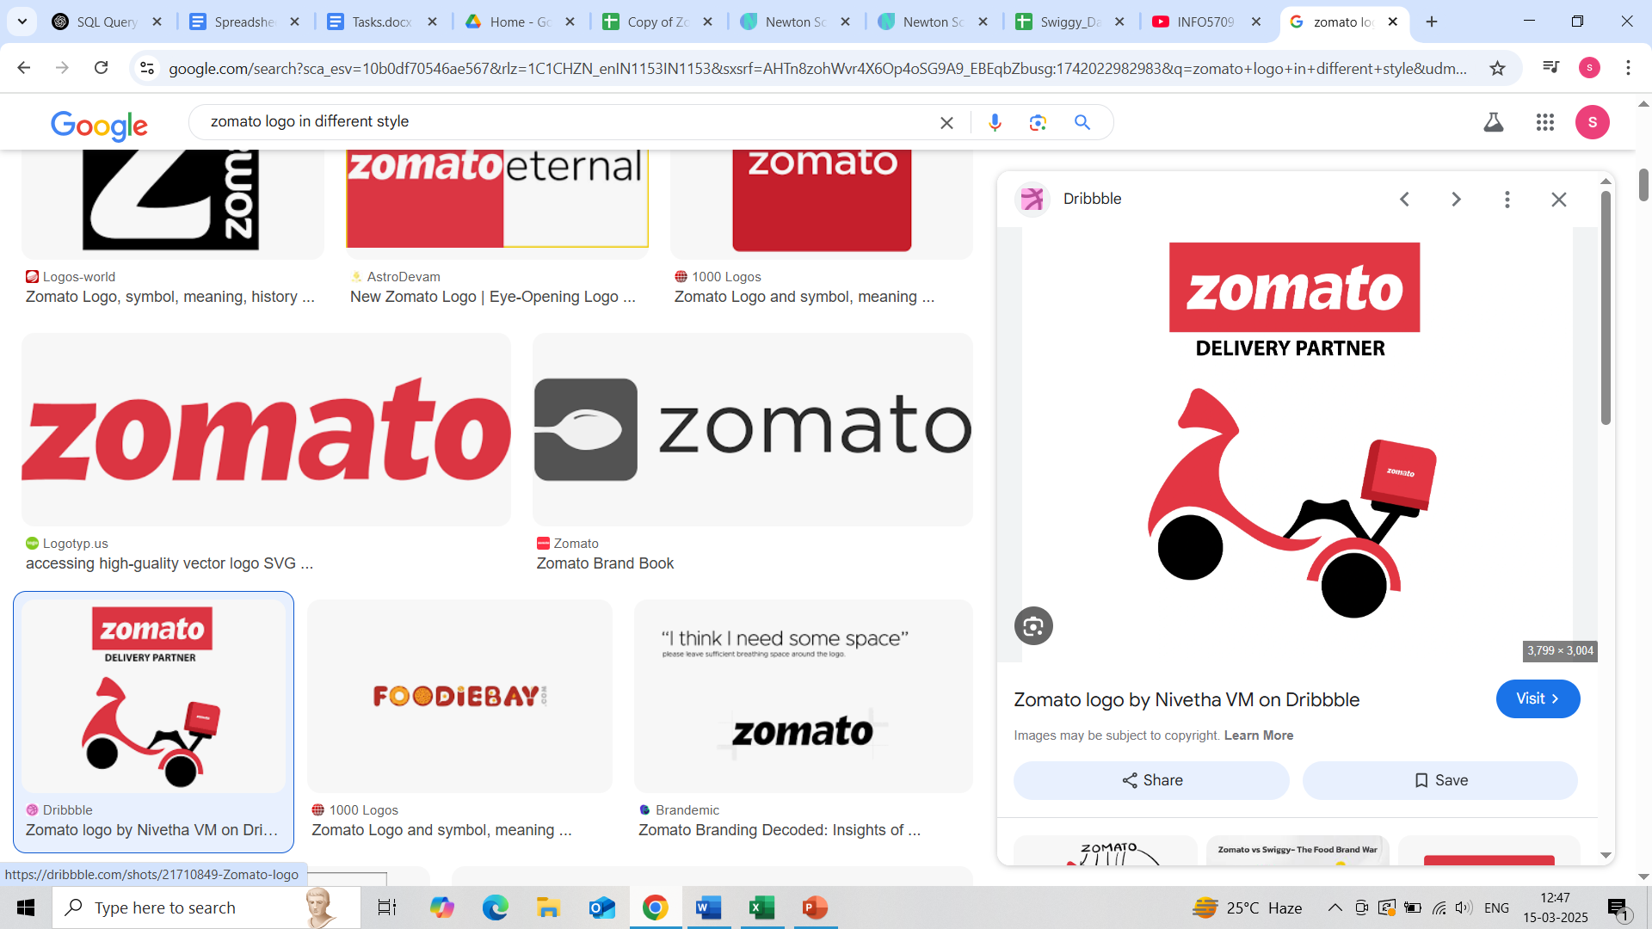
OBJECTIVE
The main objective is to analyze key data and draw useful insights
in order to make data driven decision to open new restaurants.
Focus will be on key data insights to understand
Customer preference meaning which cuisines have high demand
Identifying regions or cities where competition is less and are best suited to open new restaurant.
Customer expenditure power and targeting a specific bunch of consumers depending on their willing to spend.

Slide 7
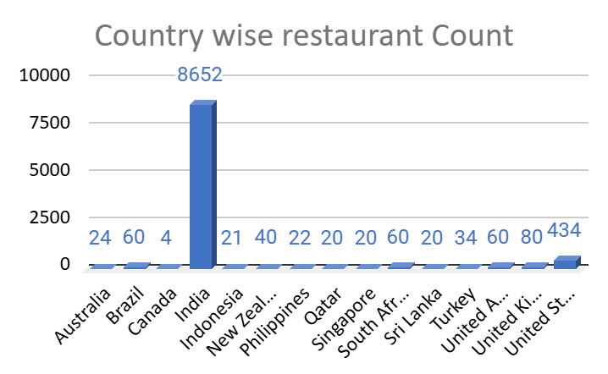
Identifying high demanding Regions
India has the largest presence: 8,652 restaurants.
USA (434) and UK (80) are established markets.
Review lower-count markets such as Canada, Qatar, and Sri Lanka for possible expansion.
Validate local demand and competition before investing.

Slide 8
Year wise Restaurants opened
Over the 9- years span (2010-2018), the number of restaurants has seen a steady growth.
High growth was seen during two phases between 2010 and 2011 and between 2017 and 2018.
Overall if we analyze the data we can conclude that Zomato has successfully maintained a steady number of restaurant openings with slight fluctuations, thus indicating a stable growth.

Slide 9
Restaurants in India with different price range
The majority of the restaurants in India (approx 50%) fall within the Price Range 1 category, which indicates affordability and value-oriented dining.
Price Range 2 & 3: A significant portion of restaurants also falls into Price Range 2 (around 33%), showing that there is a substantial market for mid-range restaurants offering moderate pricing for a more diverse dining experience.
Price Range 4 (Premium Restaurants): Only about 4.5% of the restaurants are in Price Range 4, indicating that the premium market in India is relatively smaller compared to affordable and mid-range options.

Slide 10
Cost Analysis by Country
Singapore has the highest average cost for two in this dataset.
Turkey has the lowest average cost for two.
Costs vary widely by country, so pricing should be market-specific.
Use local research to confirm customer spending capacity.

Slide 11
Country wise Restaurant Ratings
Philippines has the highest average rating in this dataset (about 4.47).
Indonesia, Turkey, and New Zealand also have high average ratings.
India's average rating is lower (about 2.77).
Investigate service quality and customer feedback before drawing conclusions.

Slide 12
Restaurant voting in different countries
Indonesia has the highest average votes per restaurant in this dataset.
UAE, Turkey, USA, and the Philippines also show strong engagement.
Brazil and Singapore have fewer average votes per restaurant.
Consider awareness campaigns to encourage customer feedback.

Slide 13
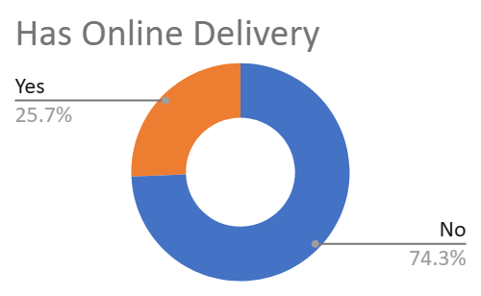
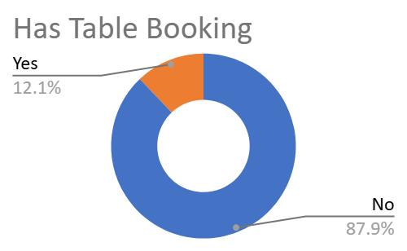
Restaurants with and without online delivery and table booking
26% of restaurants offer online delivery; 74% do not.
12% offer table booking; 88% do not.
These services may improve convenience where customers need them.
Test expansion by location and measure customer response.

Slide 14
Top 10 cuisines with highest ratings
Several cuisine combinations have an average rating of 4.9 in this dataset.
Examples include Mughlai/Lucknowi, Hawaiian/Seafood, and European/German.
Use local demand and feasibility to select menu options.
High ratings alone do not guarantee demand in every market.

Slide 15
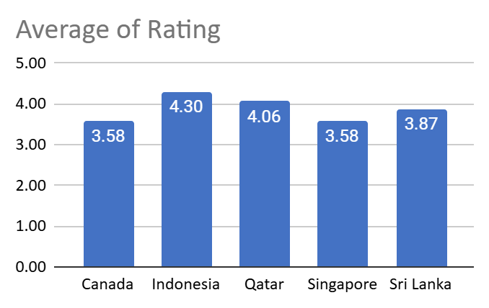
Identifying Countries of expansion opportunities
Indonesia, Qatar, Sri Lanka, and other markets show promising ratings in this dataset.
Ratings are one signal—not a complete measure of market potential.
Compare competition, customer demand, cost, and local preferences.
Validate opportunities with recent market research.

Slide 16
Restaurant Analysis
The dashboard includes interactive slicers for Country, Year, and City, enabling users to filter and analyze data efficiently.
It covers 9,551 restaurants across 15 countries and 141 cities, with an average cost for two of ₹856 and an average rating of 2.9.
There are 1,825 unique cuisines, showcasing global culinary diversity. 2018 saw the highest number of restaurant openings, totaling 1,102.
Only 26% of restaurants offer online delivery, indicating room for growth in digital services.
India leads with 8,652 restaurants, followed by the USA (434) and the UK (80)—highlighting varied market scales and pricing strategies.

Slide 17
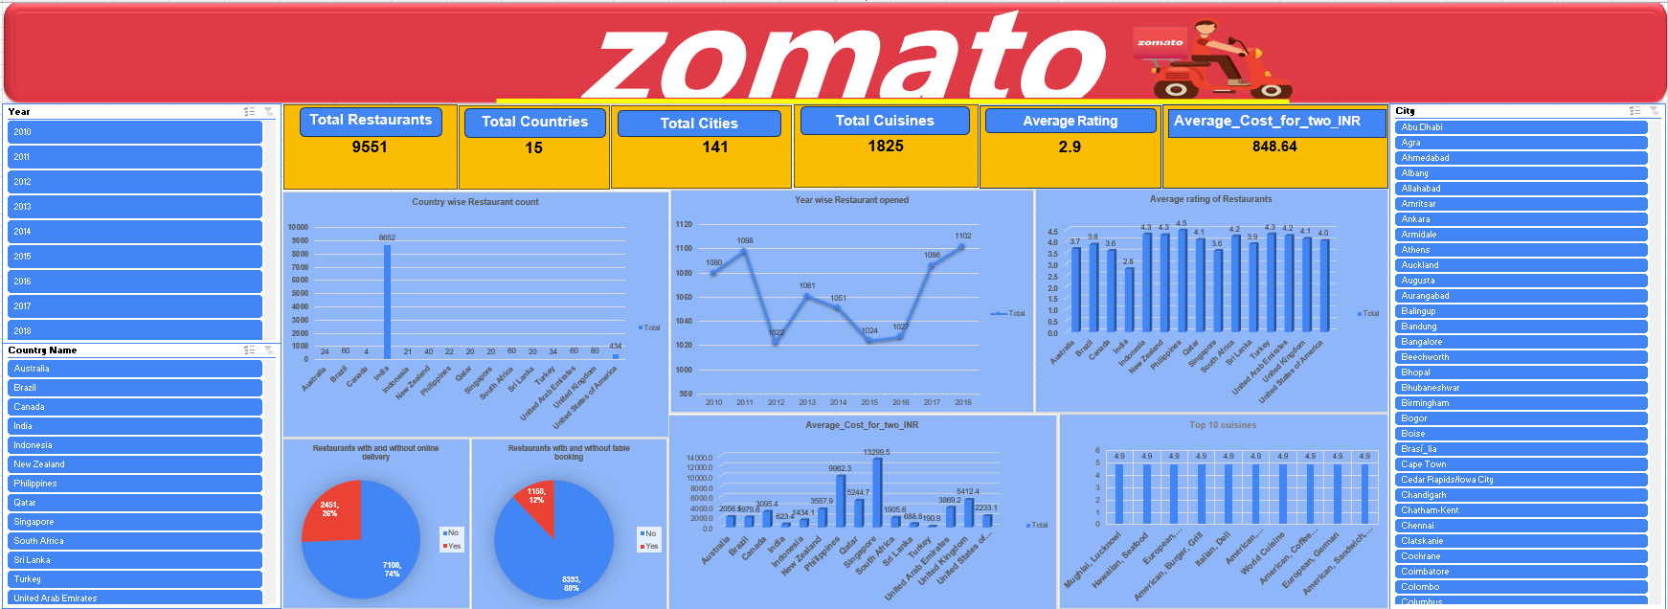
Dashboard

Slide 18
Recommendations
Turn the analysis into practical next steps
Explore underrepresented markets
Review Canada, Qatar, and Sri Lanka; validate local demand before investing.
Match cuisines to local demand
Prioritize highly rated cuisines that fit local tastes and customer preferences.
01
02
Expand convenience services
Test online delivery and table booking where customer demand supports them.
Improve customer experience
Focus on food quality, service, and feedback to build stronger ratings.
03
04
Set market-specific prices
Offer budget, mid-range, and premium choices based on local spending capacity.
05

Slide 19
Conclusion
India has the largest restaurant count in this dataset.
Some markets have fewer listed restaurants and may merit further research.
Delivery, table booking, service quality, and pricing are potential improvement areas.
Use local demand, competition, and customer preferences to guide expansion.

Slide 20


